Slide 1

Algorithms and Data Structures 2 CS 1501
Fall 2021
Sherif Khattab
ksm73@pitt.edu
(Slides are adapted from Dr. Ramirez’s and Dr. Farnan’s CS1501 slides.)

Slide 2
Announcements
Upcoming deadlines:
Homework 1, Homework 2, Lab 1, and Tophat questions are due on 2/8
Assignment 1 is due on 2/19
Piazza is the main communication mechanism with the teaching team
Slack is for student-to-student communication
SheInnovates: Starting 2/5
Pitt’s only all-women hackathon
http://sheinnovates.us/
Job Talk: 2/5 at 1:00 pm
https://pitt.co1.qualtrics.com/jfe/form/SV_391YsRaJ4mPBUX3

Slide 3
Last lecture …
Tree ADT
Definitions
Traversals

Slide 4
Muddiest points
Tail recursion
Are there other things besides tail recursion?
Understanding the tail recursive graphically
Why was the traversal tail recursion if there was a second recursive call
I’m still struggling with Runtime I get the theory but struggle to apply it
why stringbuilder is better than string objects
different binary tree traversal methods
level order traversal
level order code implementation
how to memorize preorder vs inorder vs postorder
which traversals are most commonly used for binary trees
complete/full binary tree terminology

Slide 5
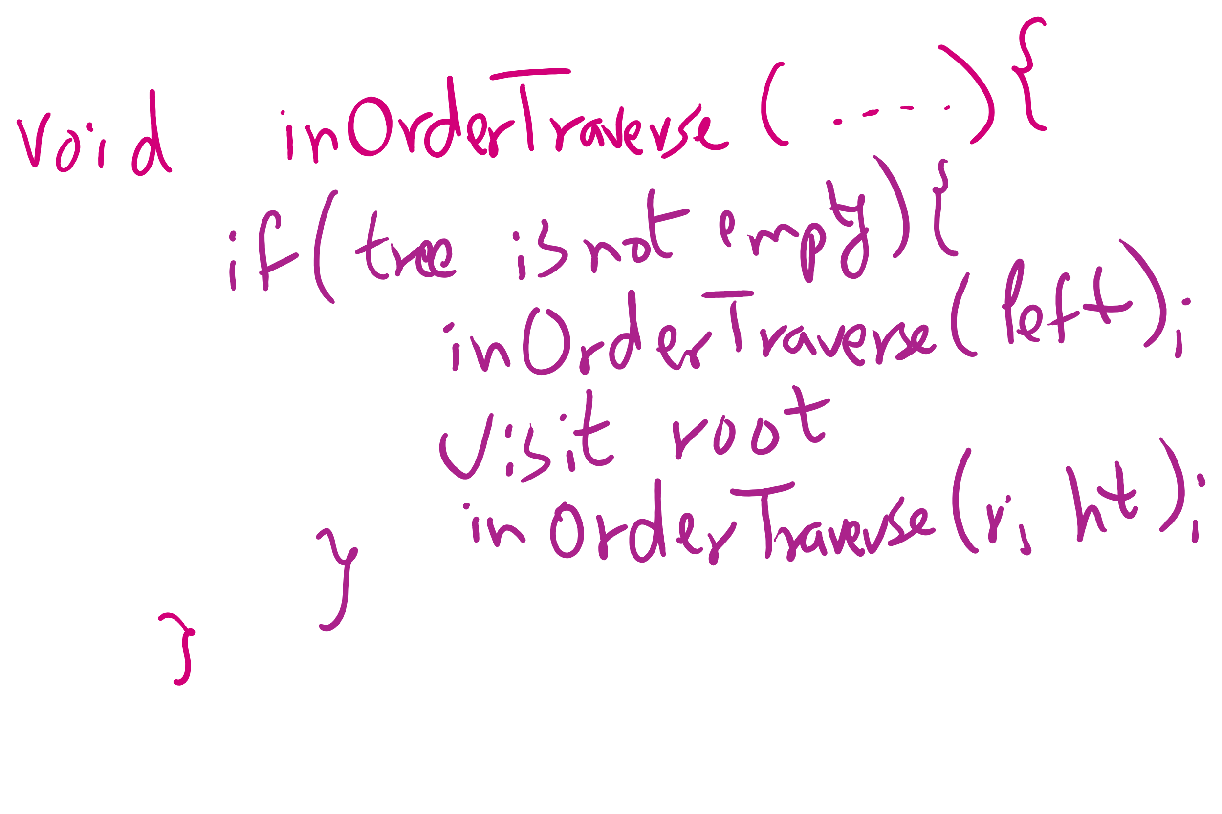
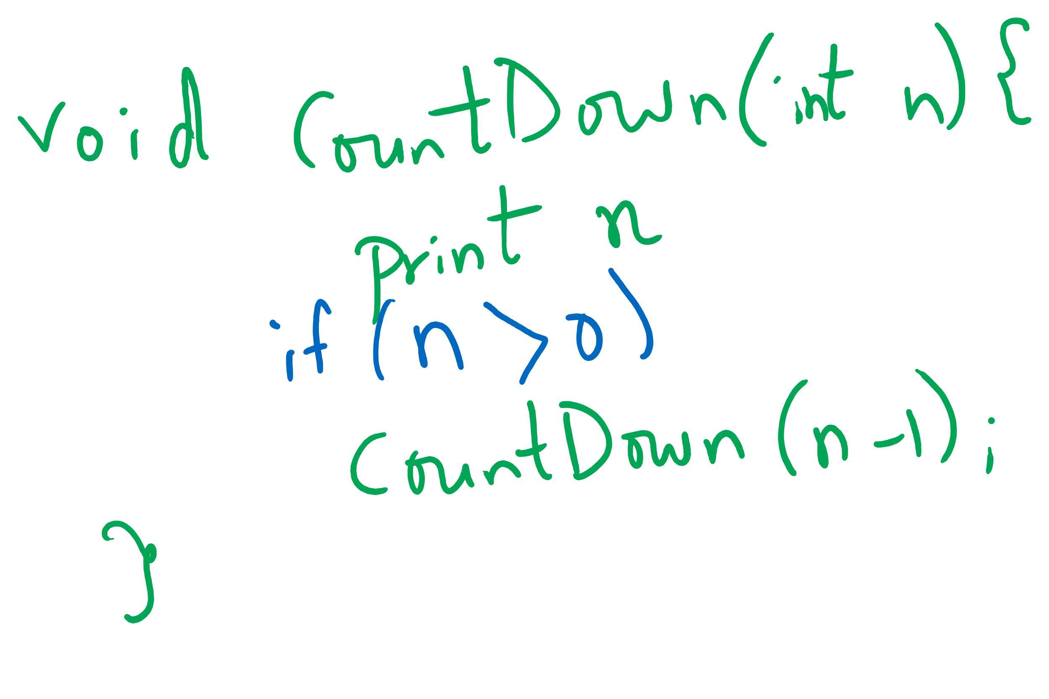
Tail-recursive Examples

Slide 6
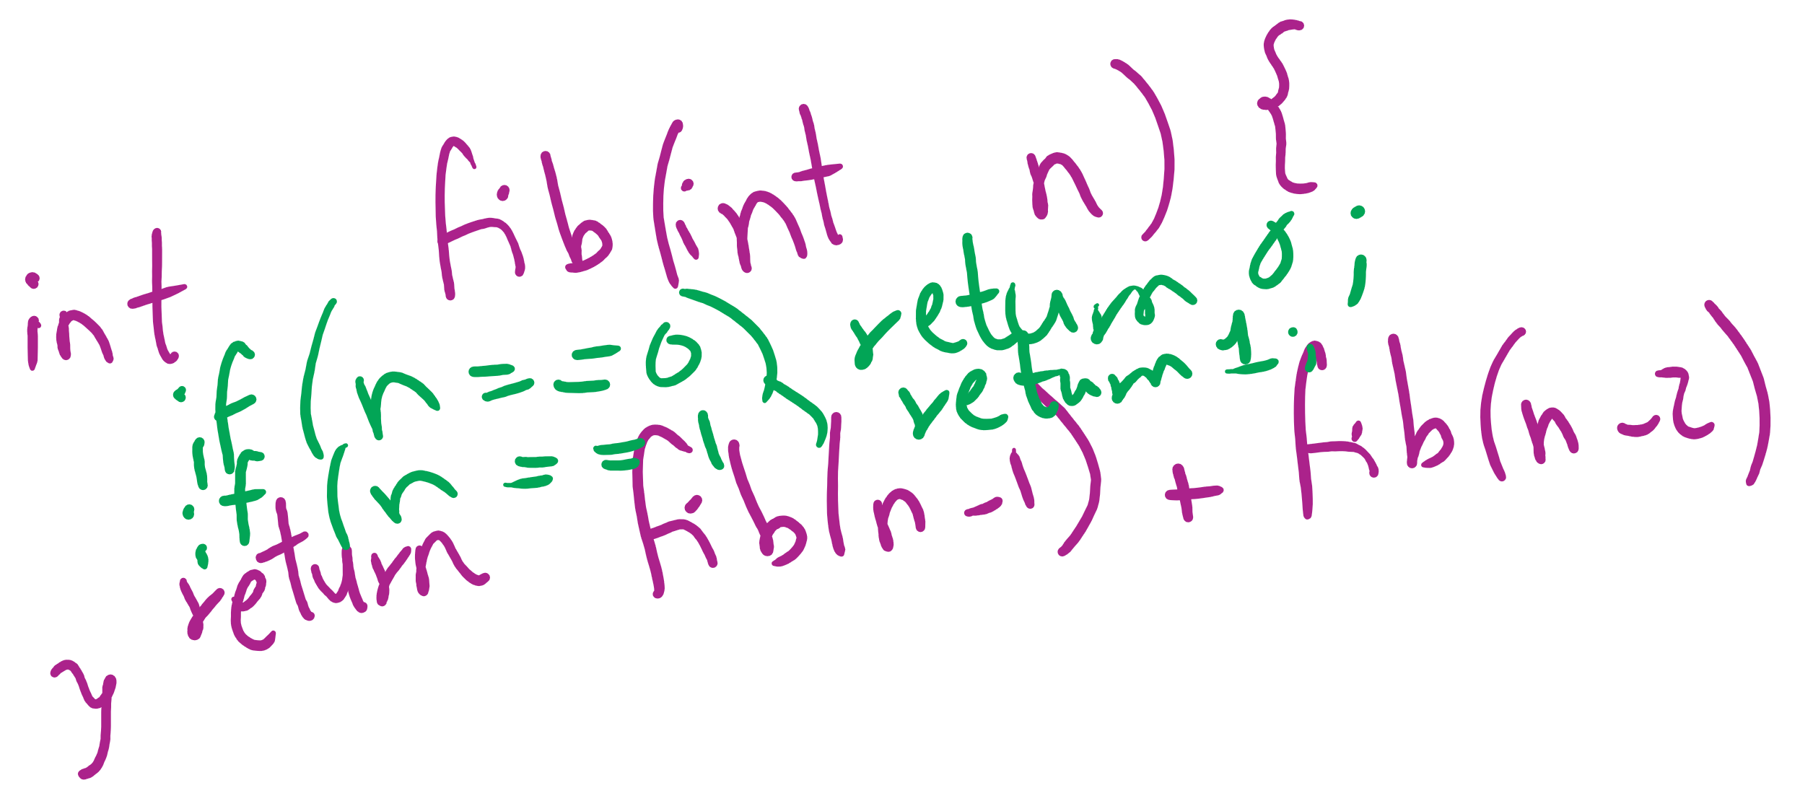
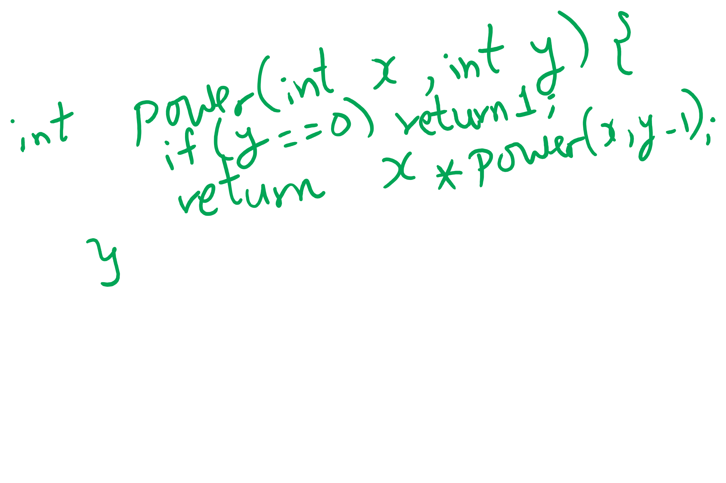
Non-tail recursive Examples

Slide 7
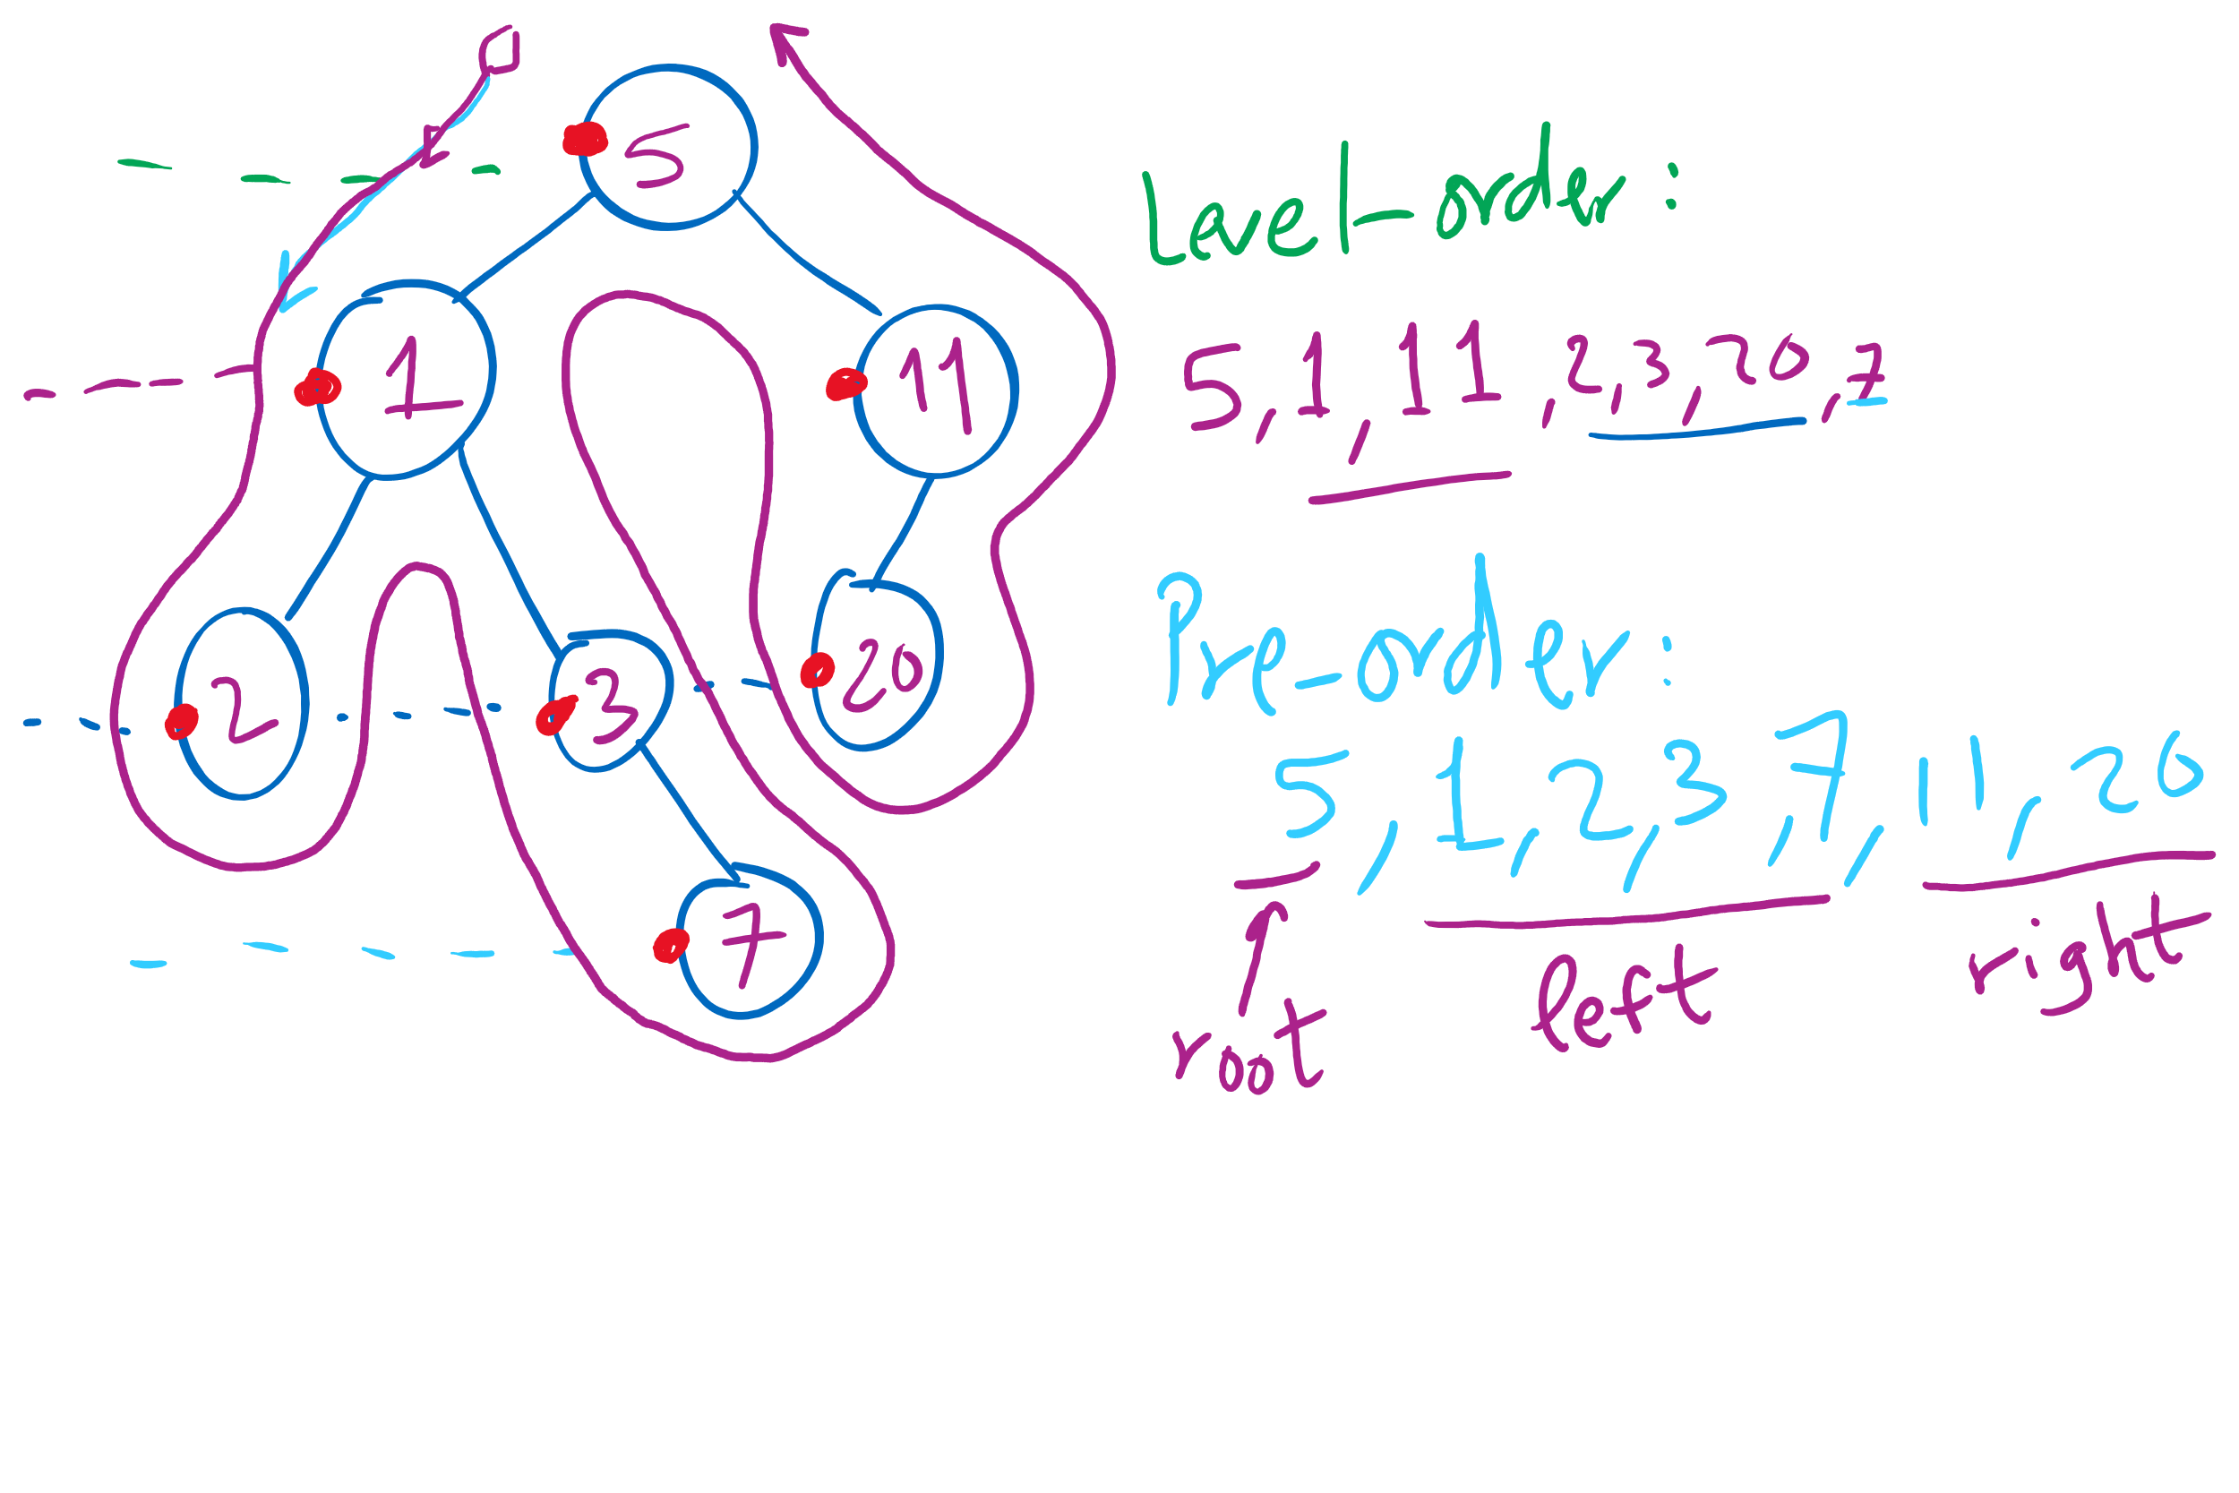
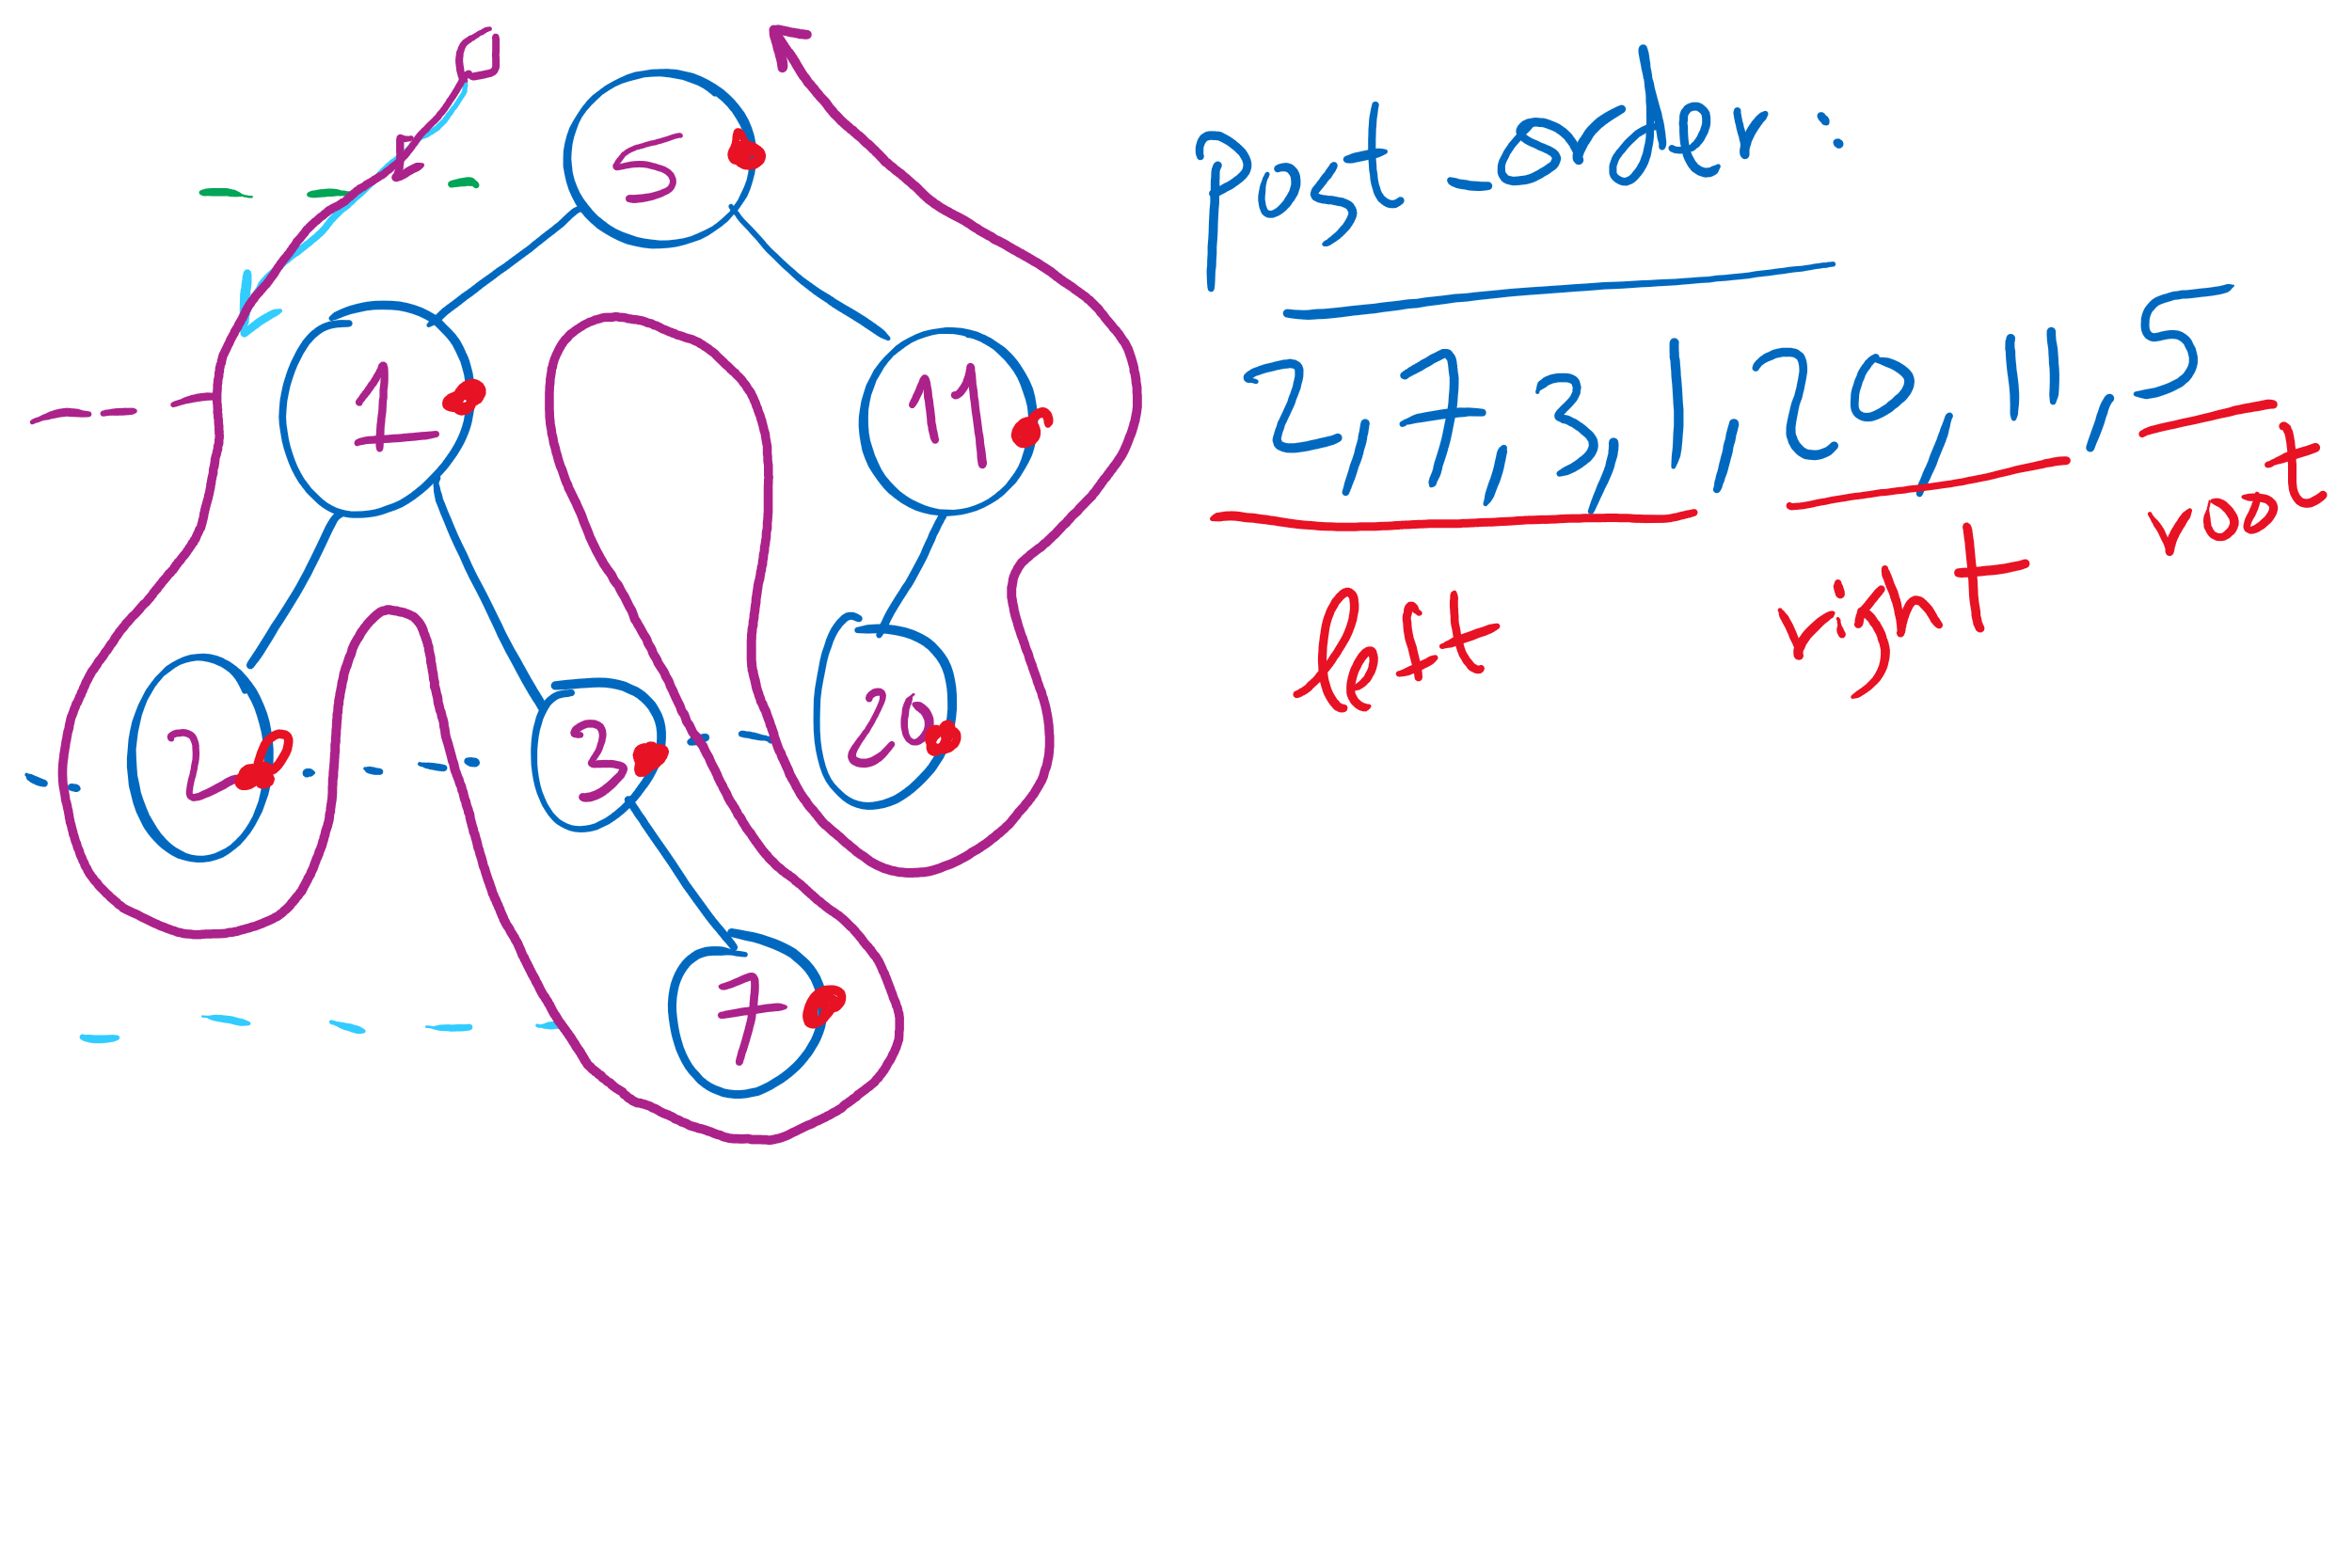
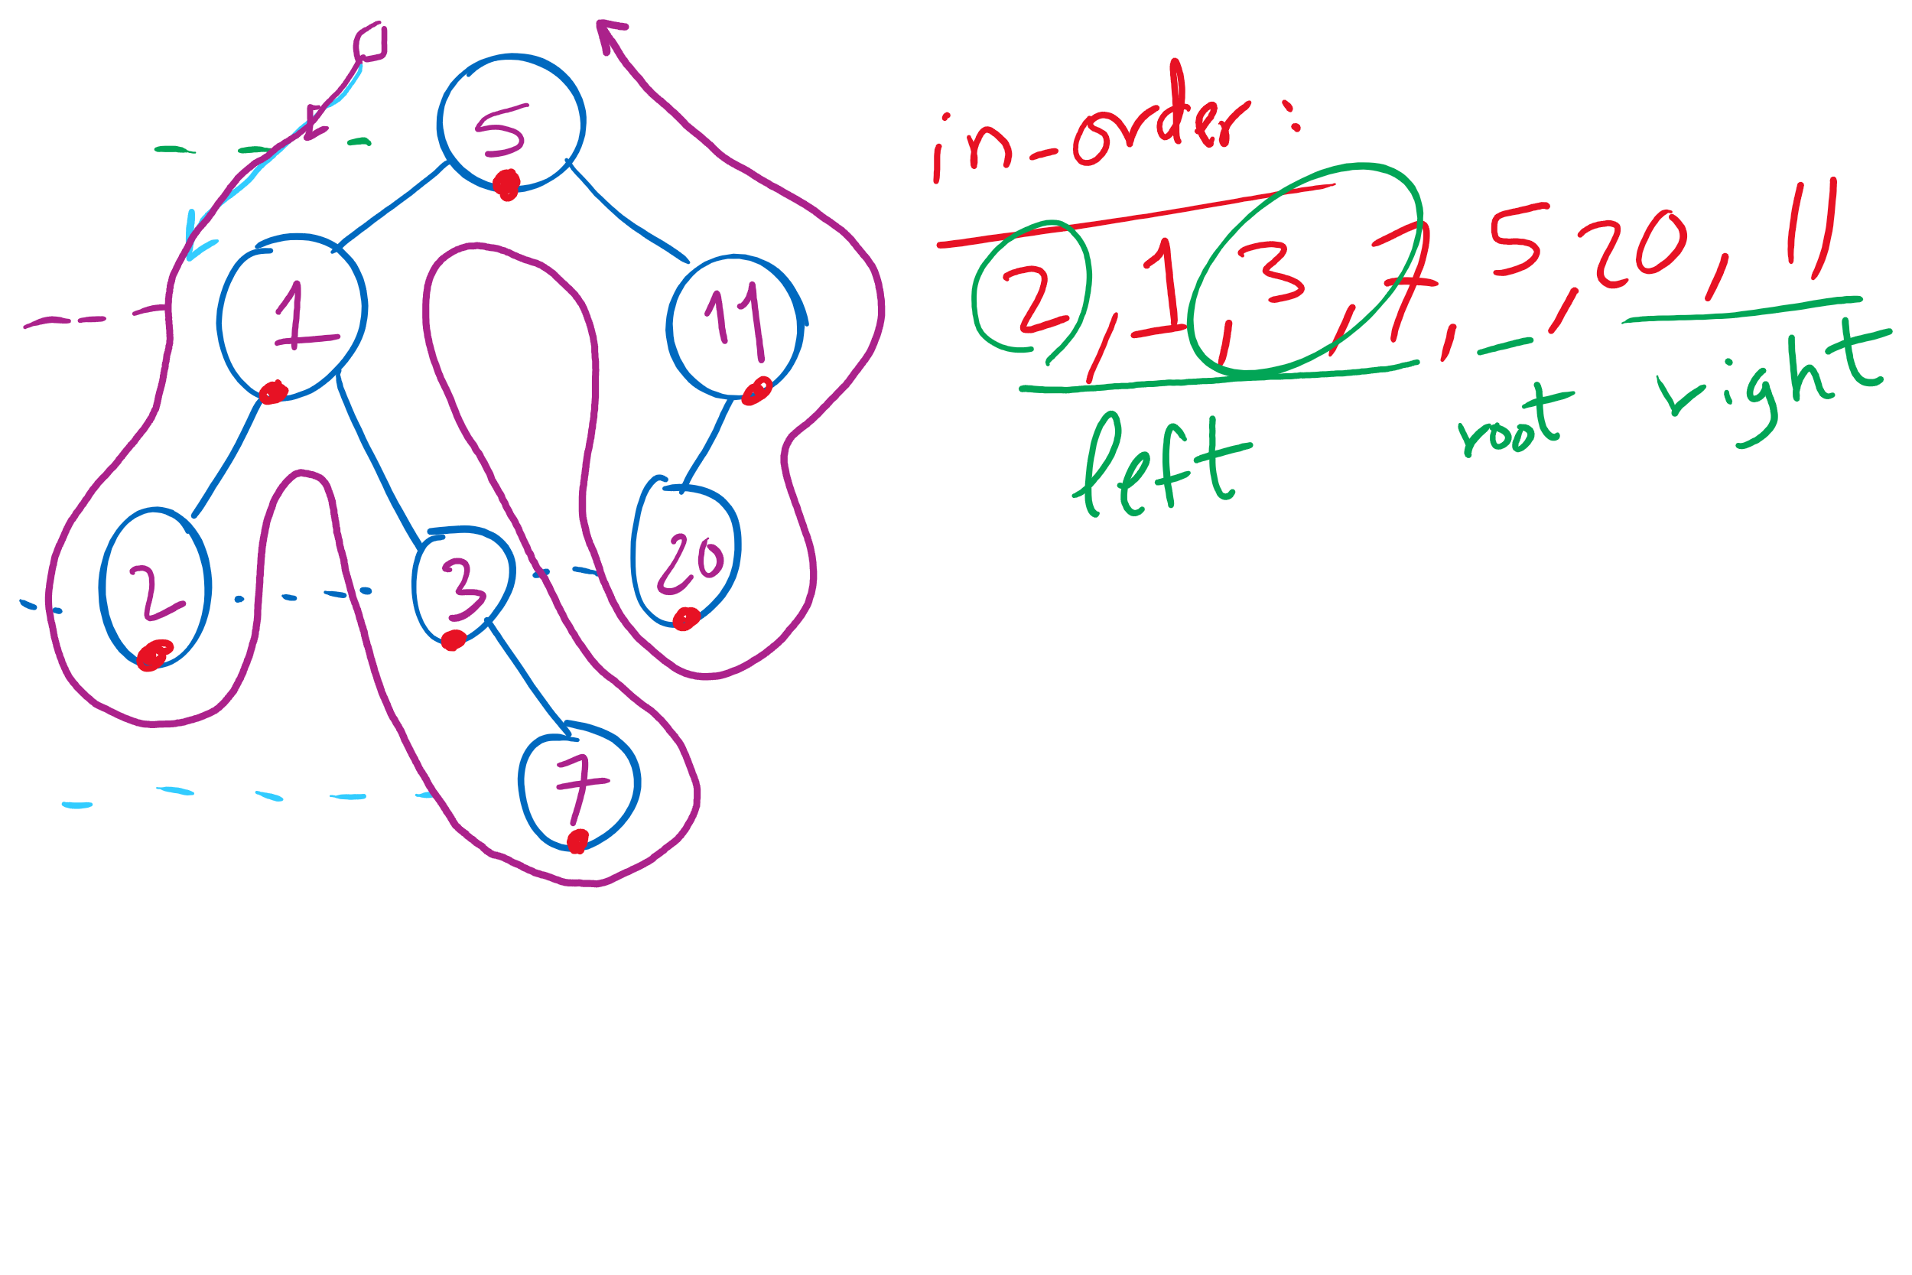
Tree Traversal Example 1

Slide 8
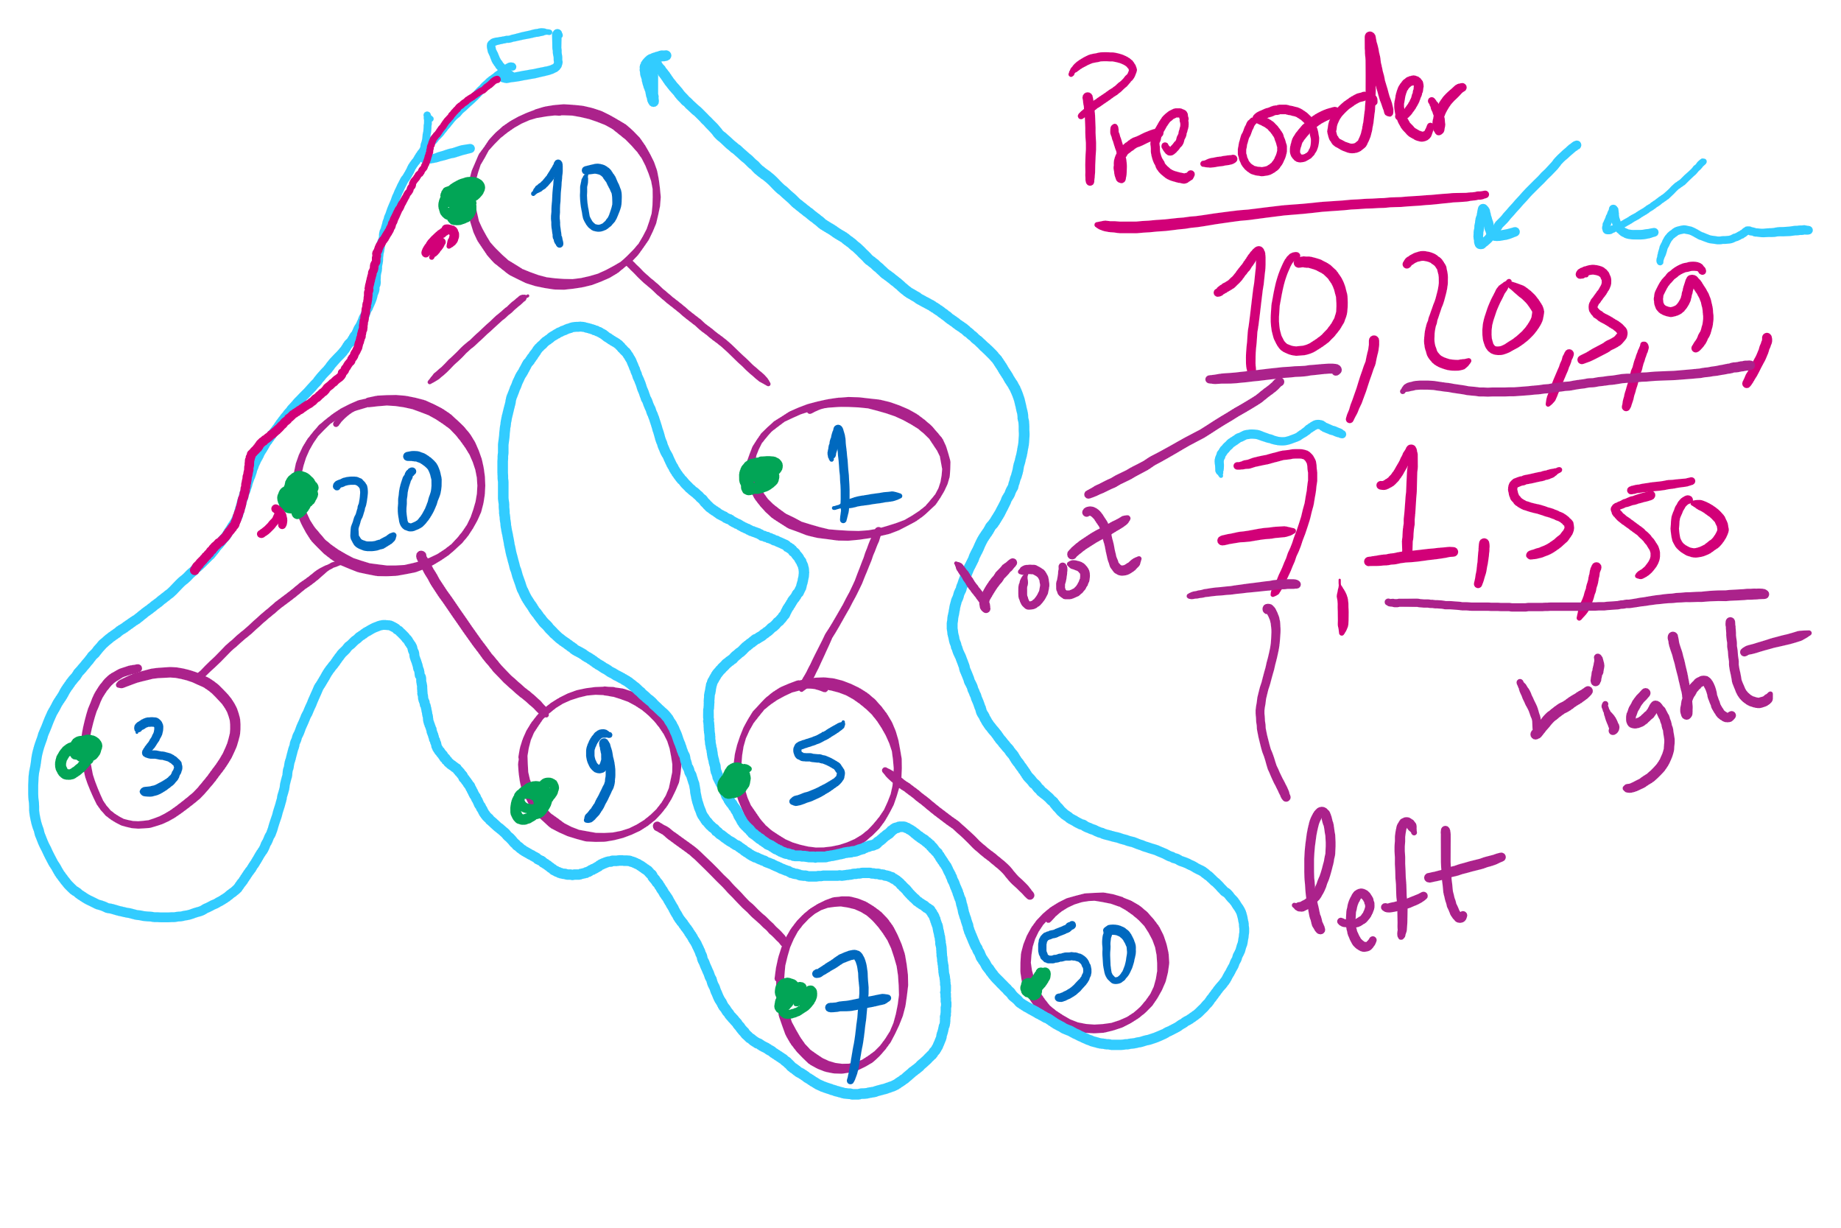
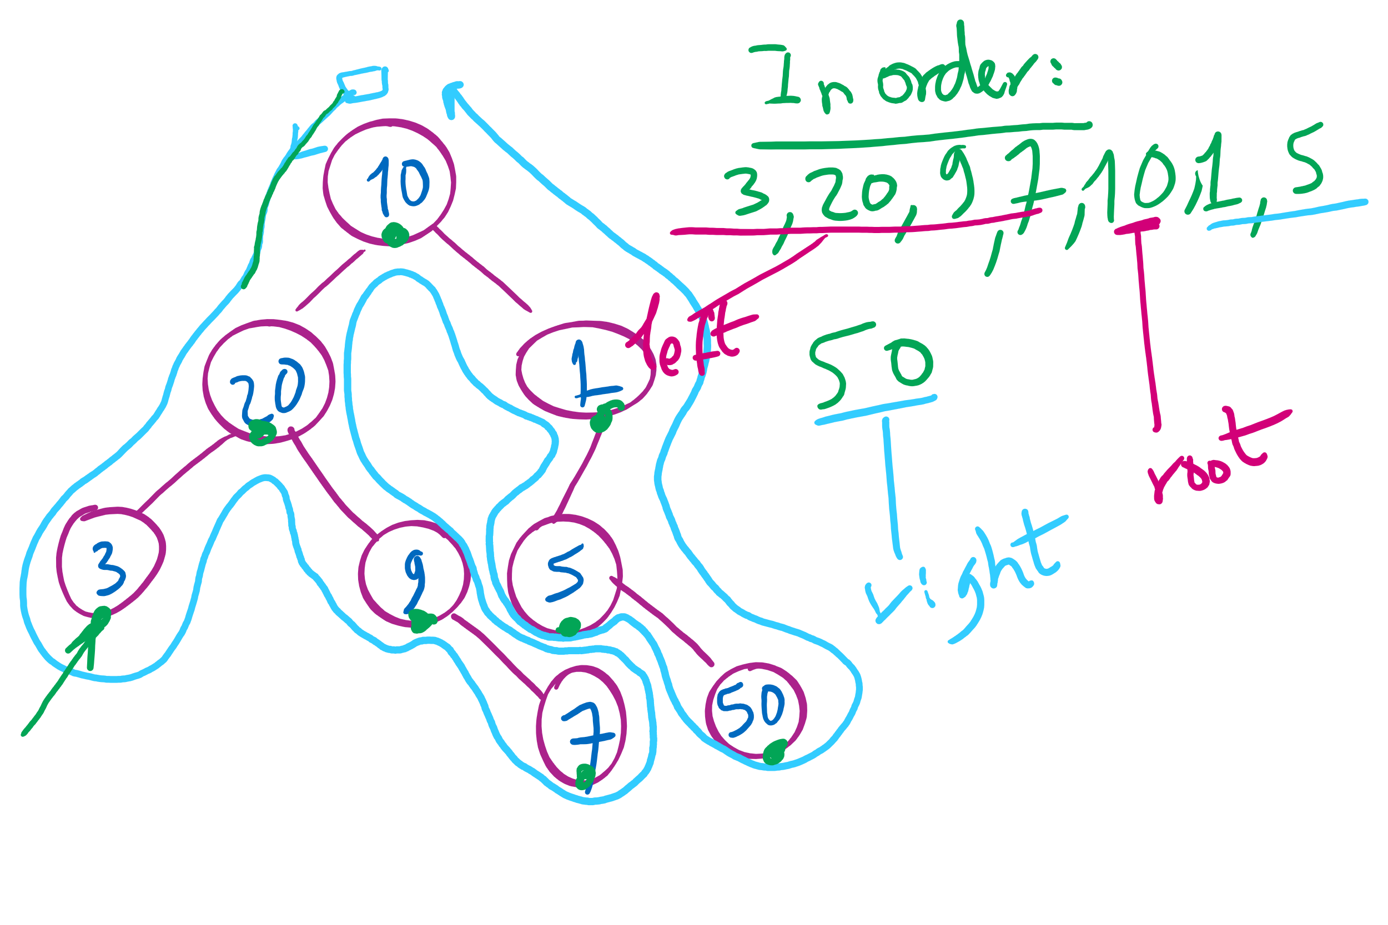
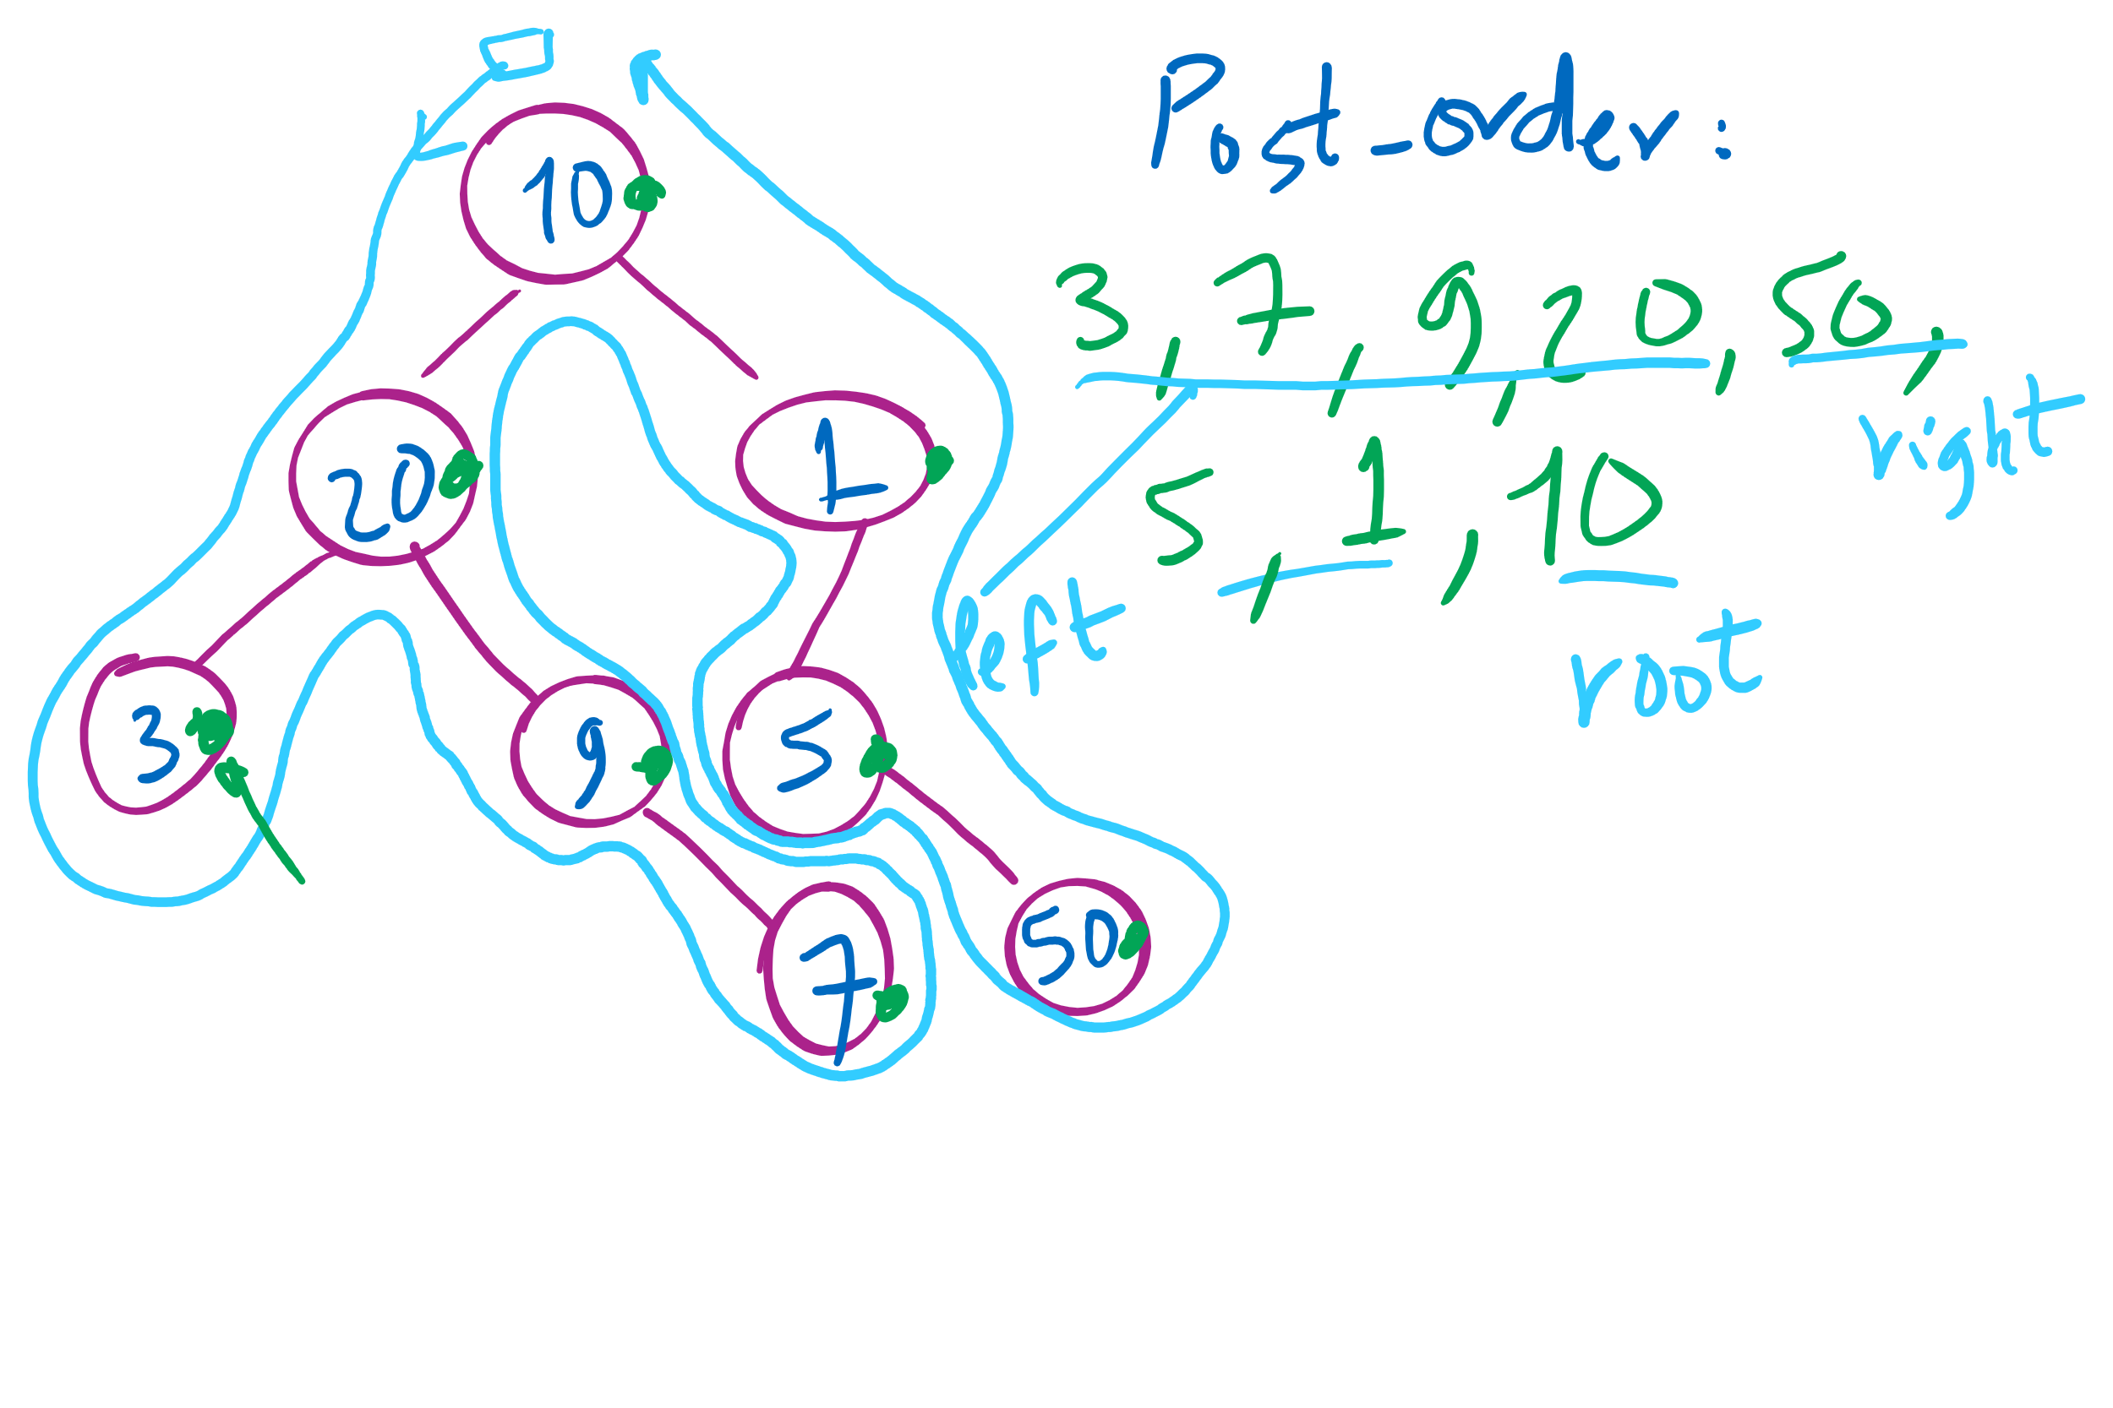
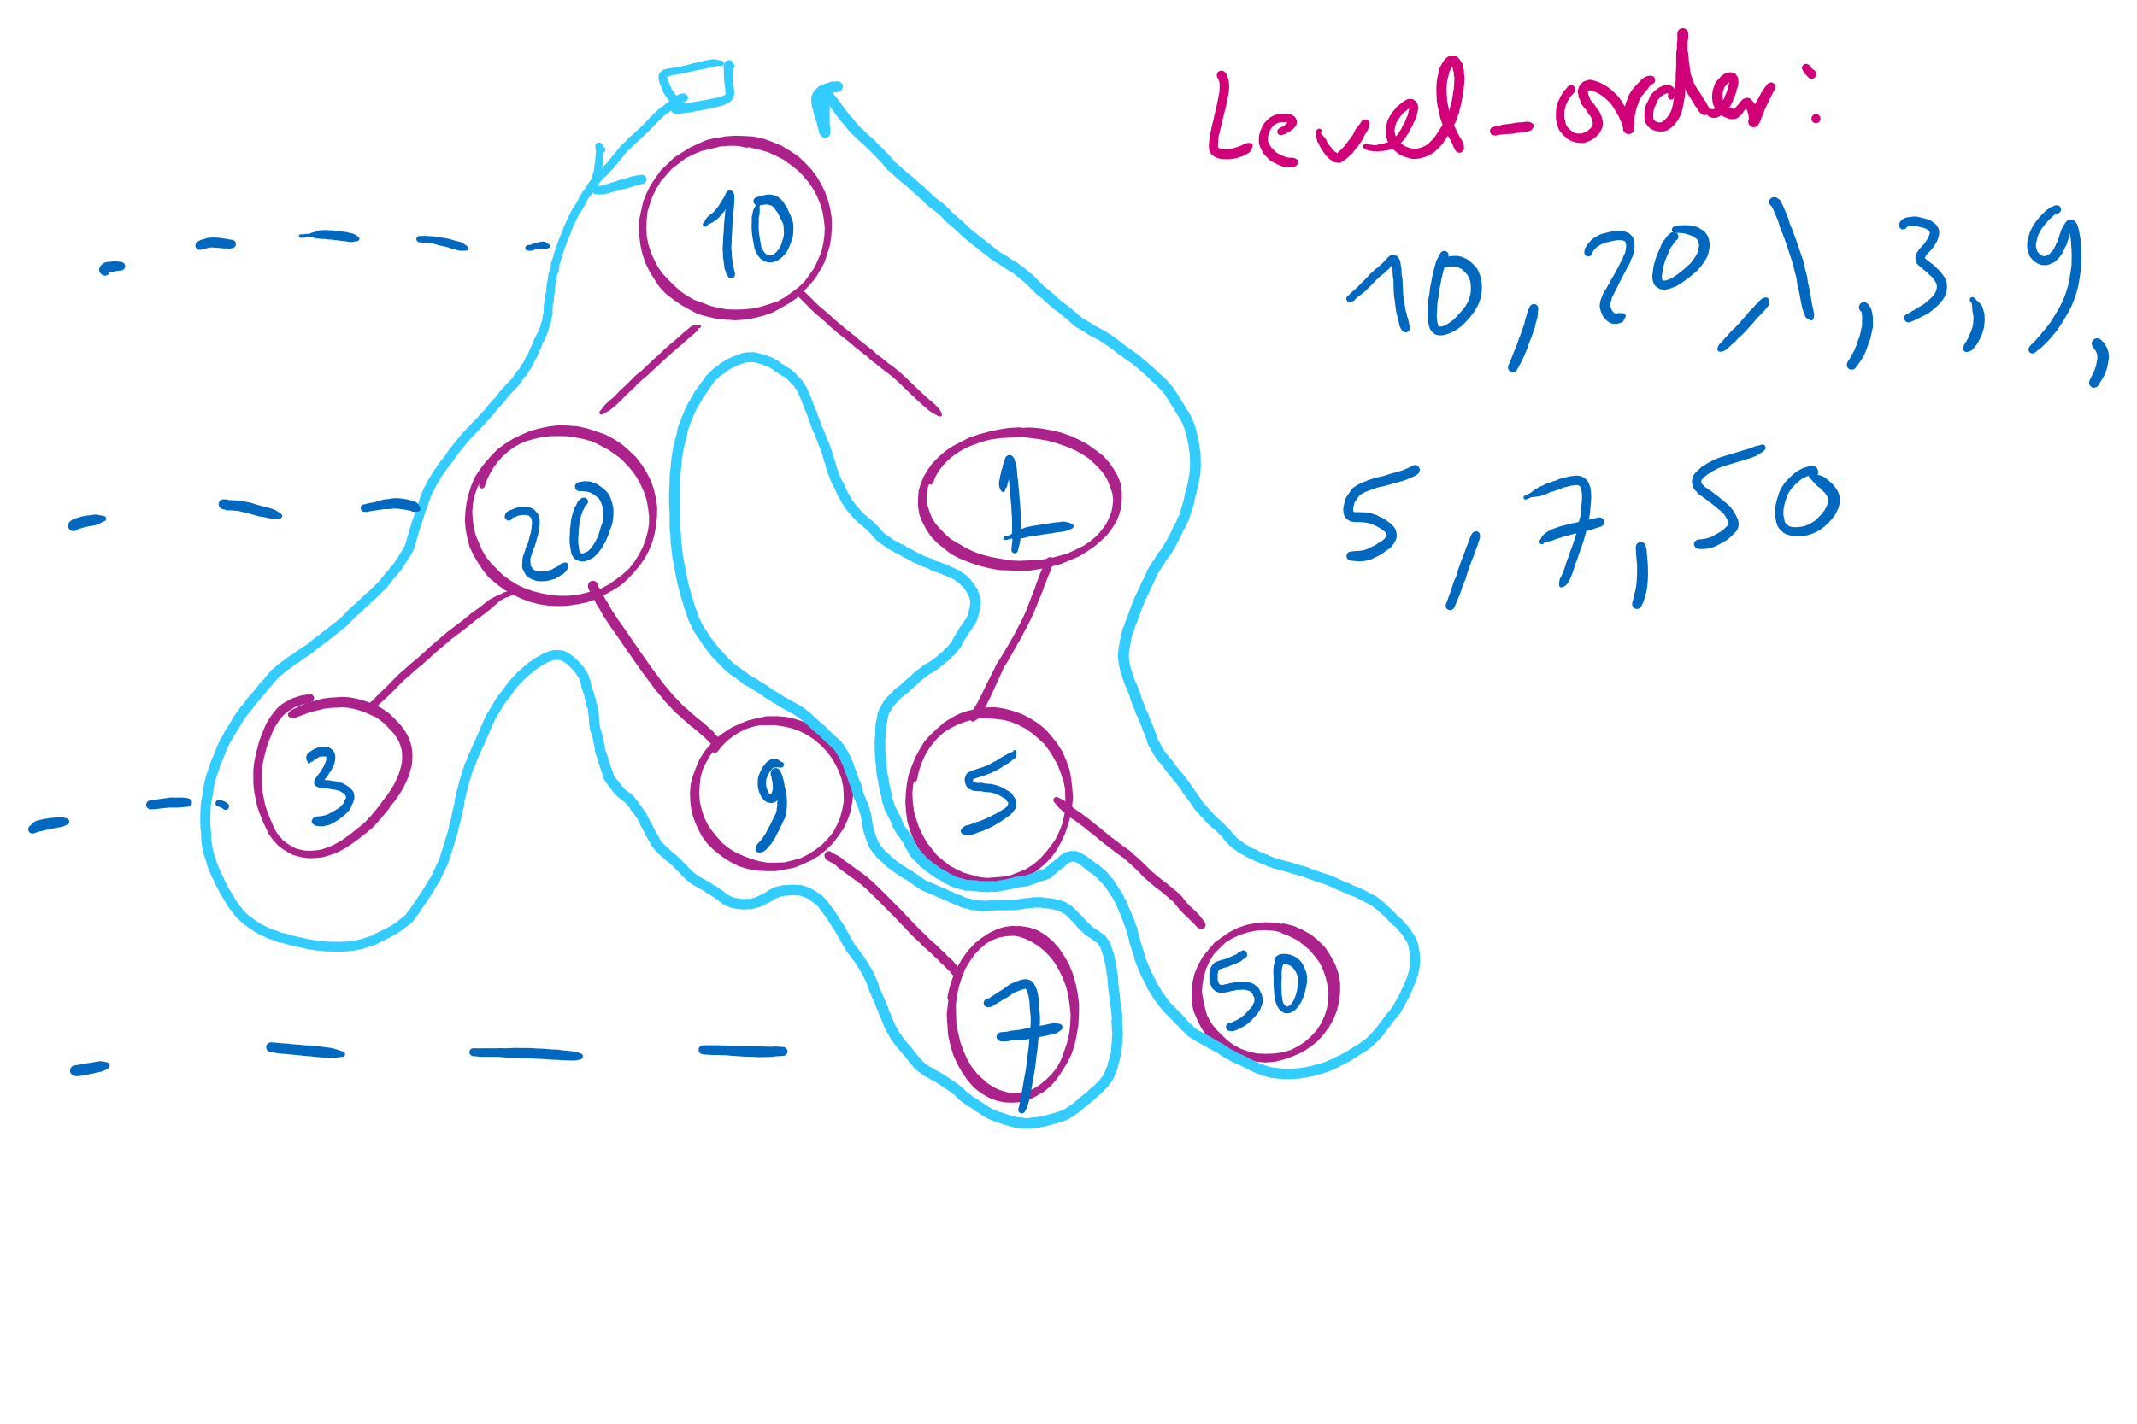
Tree Traversal Example 2

Slide 9
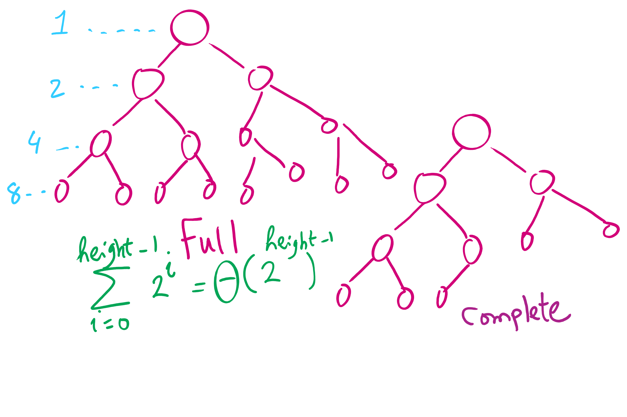
Full vs. Complete Tree

Slide 10
This Lecture
TreeADT Implementation
TreeInterface and BinaryTreeInterface
Linked Implementation
BinaryNode
BinaryTree
BinarySearchTree
SearchTreeInterface
BinarysearchTree

Slide 11
Code Walkthrough
Available online at:
https://cs1501-2214.github.io/handouts/TreeADT/Slides/
The slides are under the TreeADT/slides folder in the handout repository
https://github.com/cs1501-2214/handouts

Slide 12
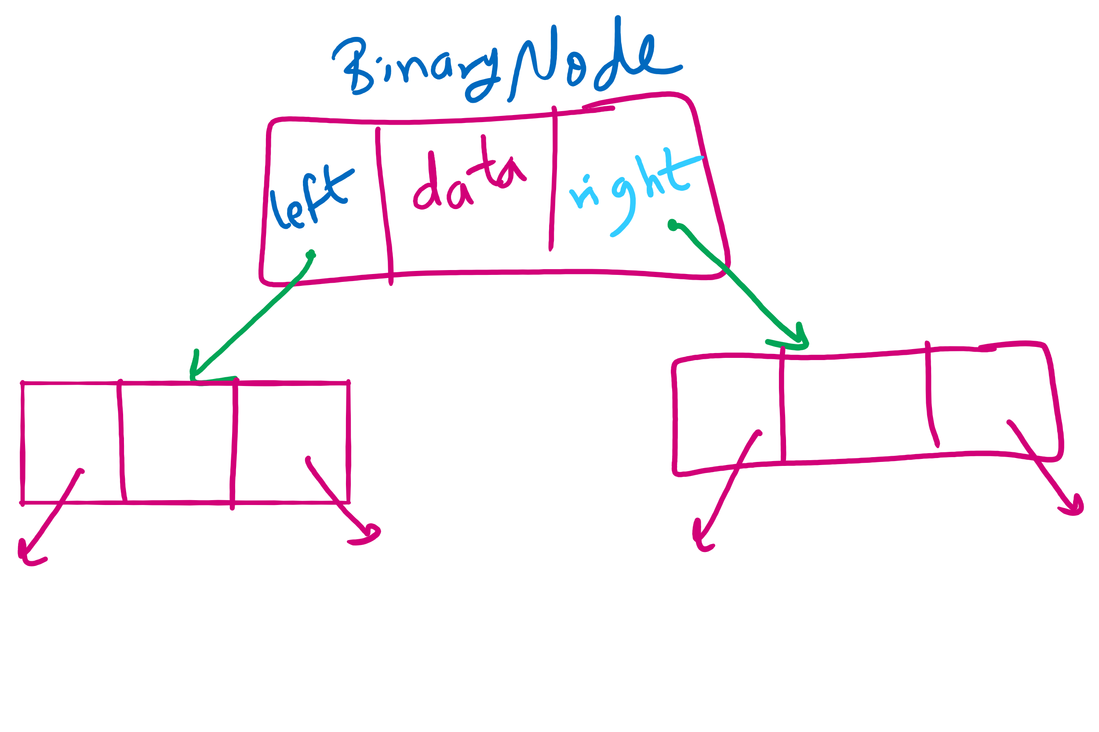
BinaryNode

Slide 13
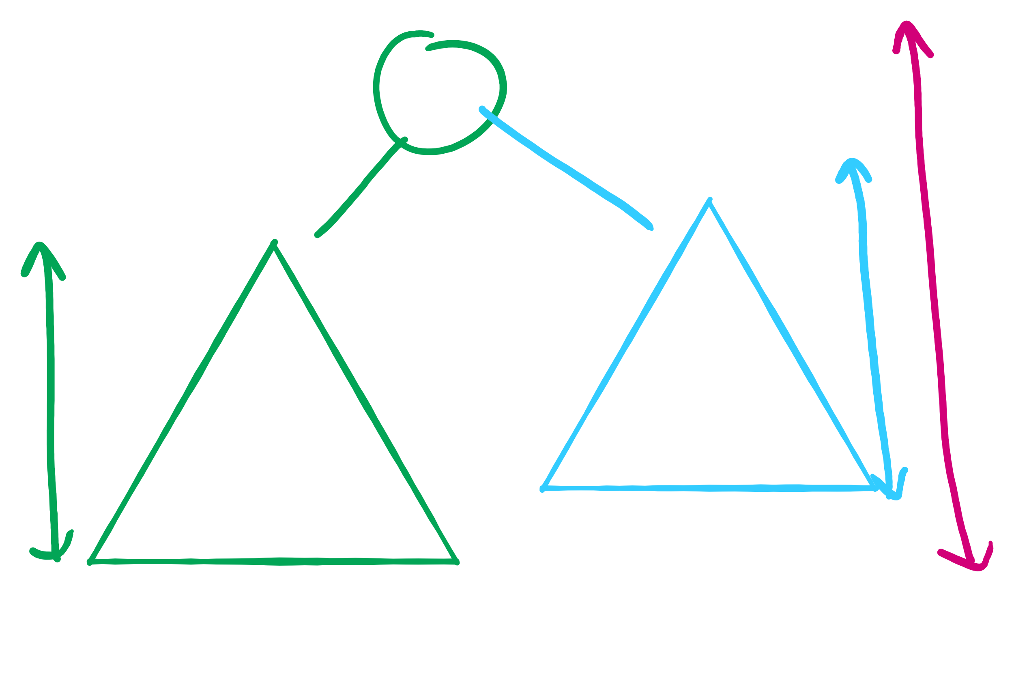
Tree Height

Slide 14
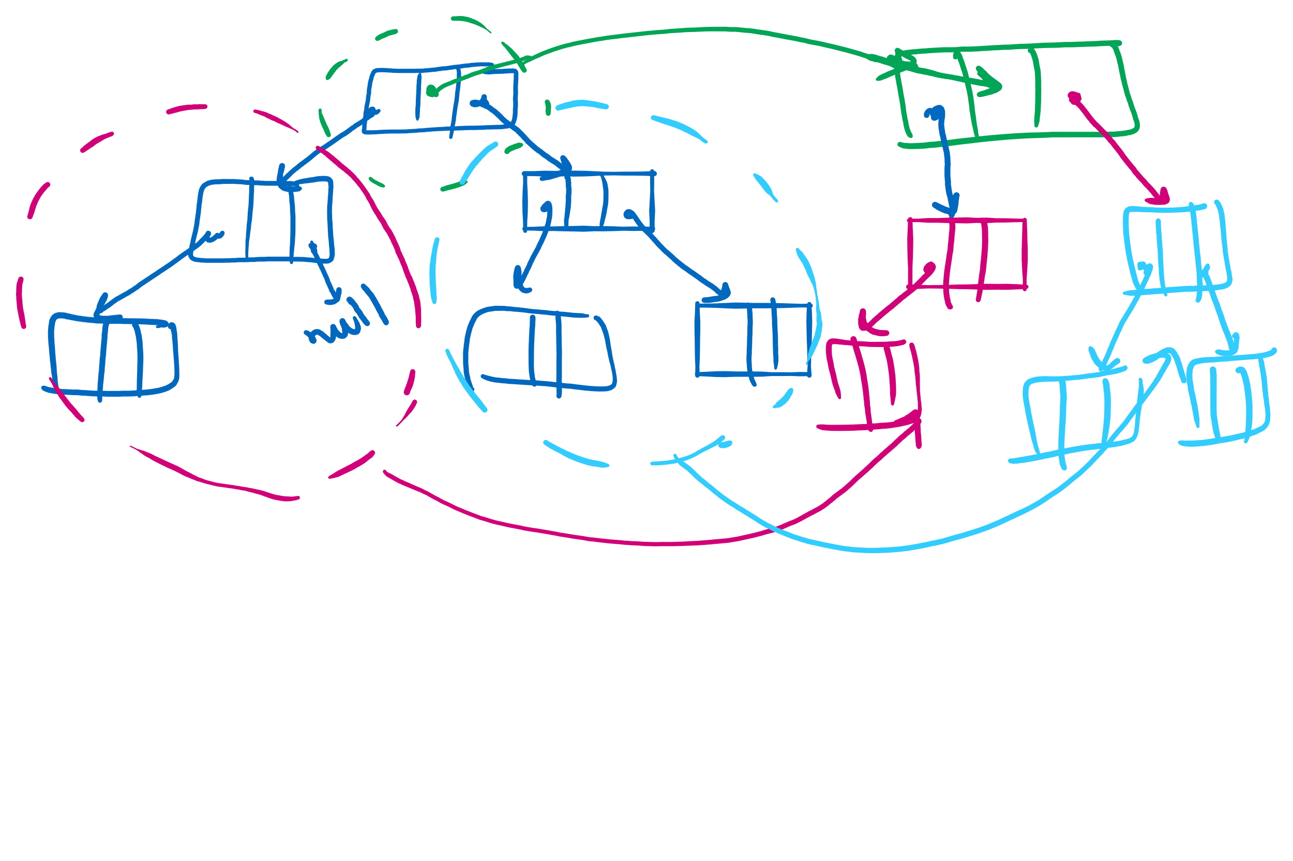
BinaryNode.copy

Slide 15
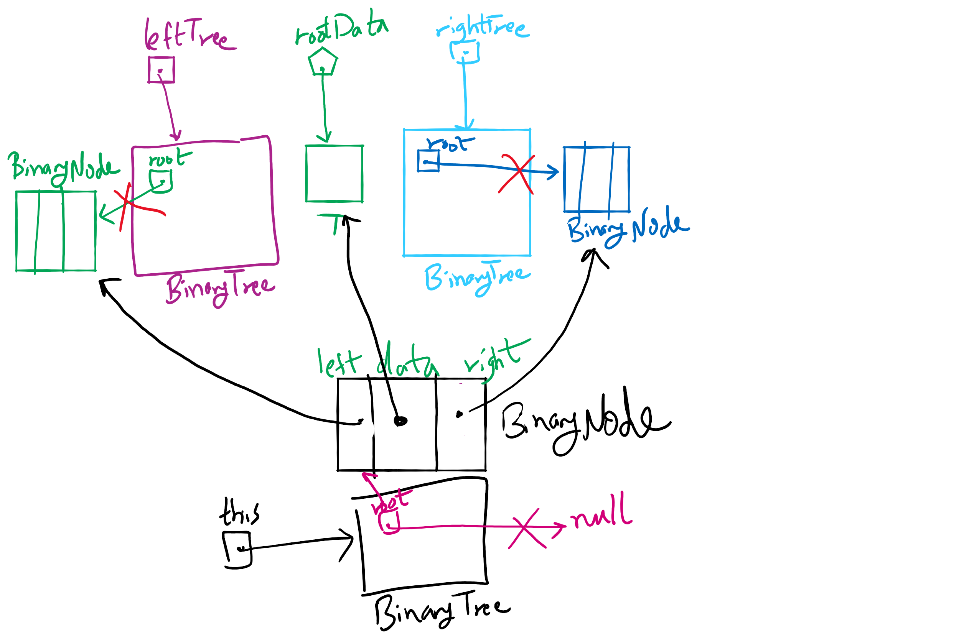
privateBuildTree Method

Slide 16
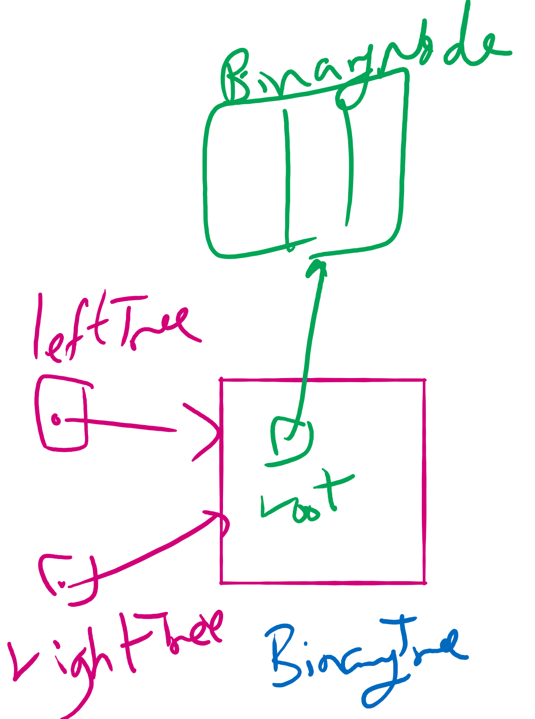
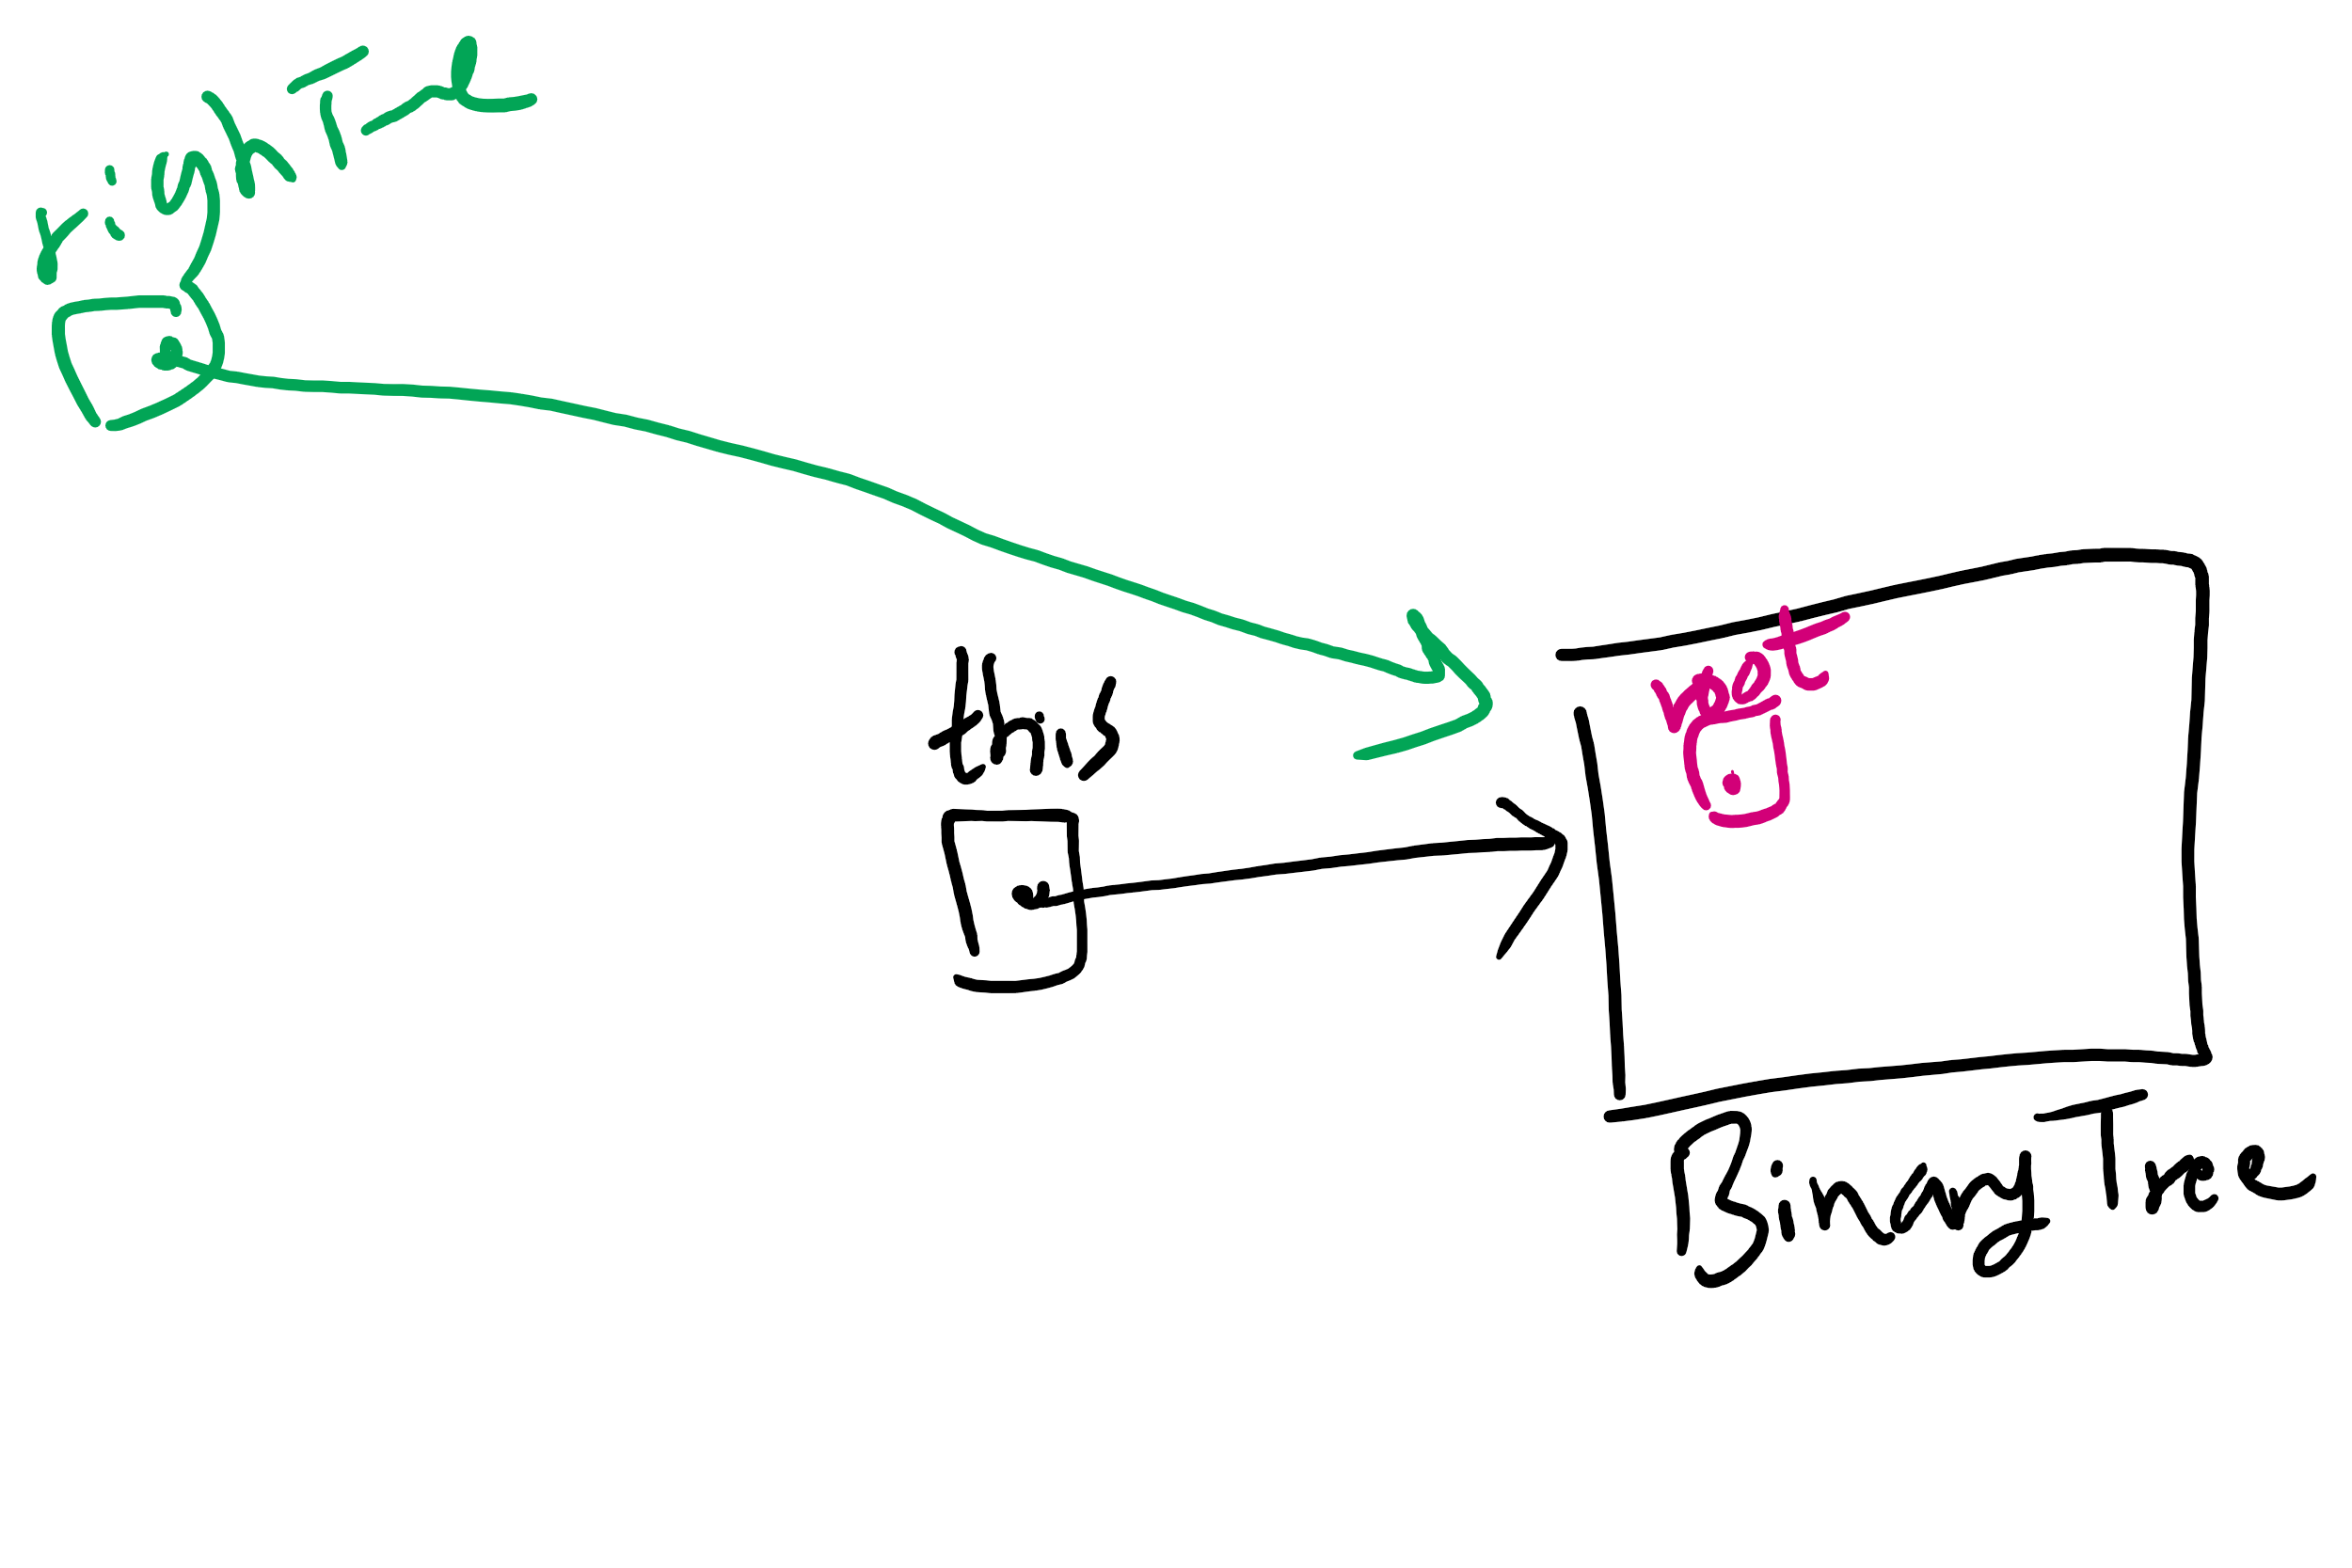
privateBuildTree Corner Cases

